Slide 1


Temperature Data Exploration
Ironhack Mid Bootcamp Project
João Cabral,
August 2022
Notes:
The goal of this project is to explore Global and Local temperature measures during a certain time period.
For local temperature exploration I am focusing in Portugal

Slide 2

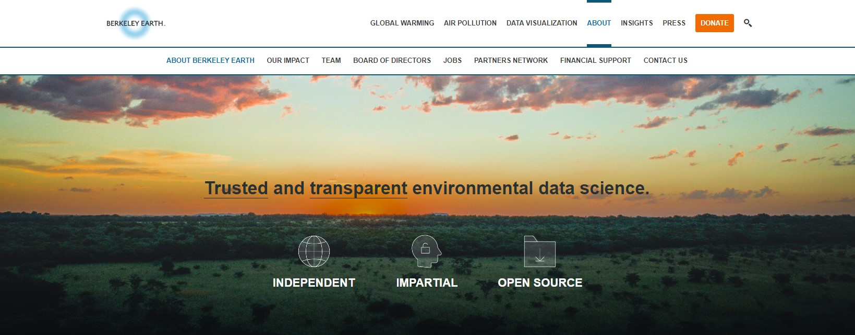

Dataset
1.6 Billion temperature reports
From 1750 until 2015
http://berkeleyearth.org/data/
Notes:
Updated by Berkeley Earth - non-profit organization focused on environmental science.
This case study has 1.6 billion temperature reports from 16 pre-existing files, so great work on their side!

Slide 3
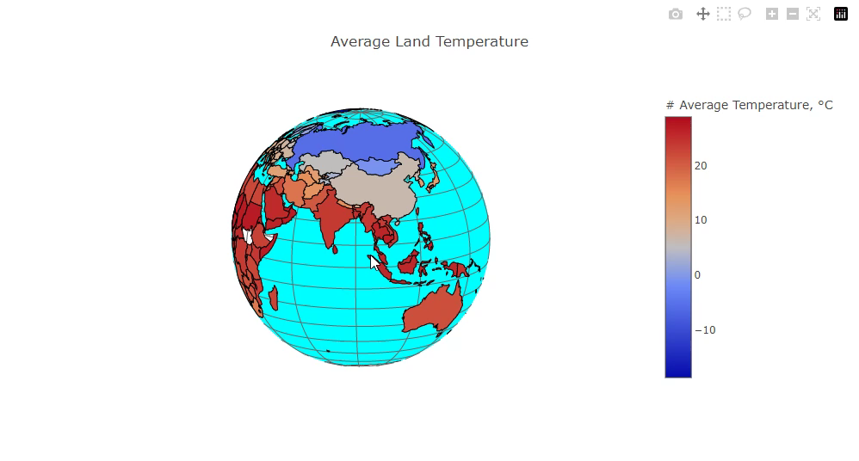
Notes:
Informational Plot.
User can select a country of interest and check its average temp

Slide 4
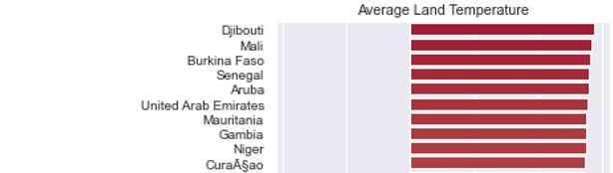

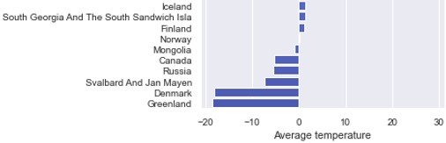


Hottest Country: Djibouti 🔥
Coldest Country: Greenland ❄️
VS
Notes:
Informational Plot
Here we can easily identify which is the coldest and hottest country

Slide 5
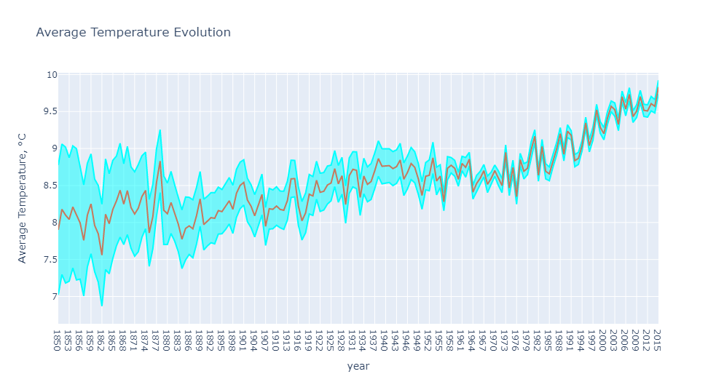


Up we go!
Notes:
In this plot we finally can start to verify some interesting facts:
-Brown – AVG temp
-Blue – uncertainty levels
Clearly an overall increase of temperature, SPECIALLY since late 1960’s (DRAW LINE)
Since 1850 until now average temperature has increased almost 2ºC!

Slide 6
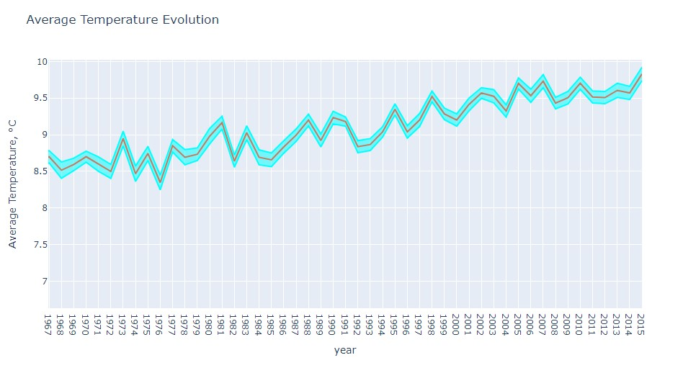

Notes:
I have zoomed in the lates 60’s to show that there is an opportunity to explore what happened at that time.
The majority of temperature increase is happening since 1975.
Until 1981 there was na average increase of 0,08ºC per decade, but since 1981 there is an increase of 0.18ºC per decade!

Slide 7

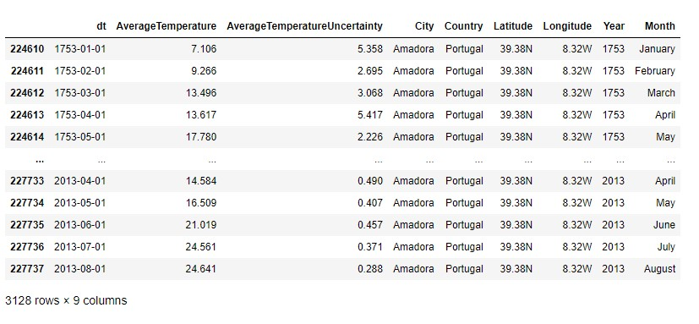
Notes:
PORTUGAL:
You can only see one city (Amadora) because measures were only done at that city. So I’m taking Amadora as Portugal refference values.

Slide 8
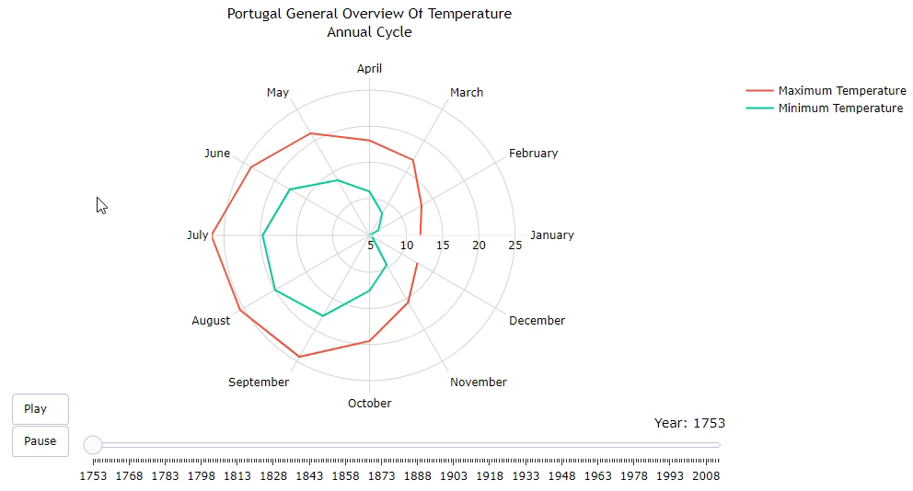
Notes:
This plot is to study the variation of average temperature BETWEEN the avg max AND avg min.
It’s an informational plot, where user has freedom to filter data of interest
((( r – Correlation Coefficient = covariance divided by individual standard deviation. it’s a normalized measurement of how the two are linearly related. sigma – Standard deviation )))

Slide 9
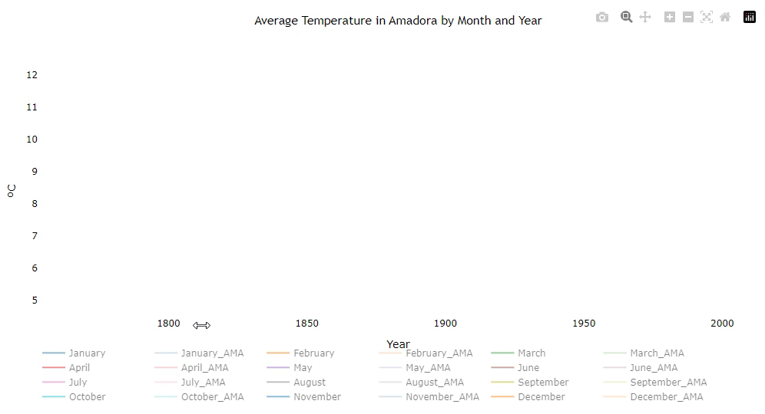
Notes:
Here in this plot we can start to gather some conclusions:
The months with AMA - average temperature for Amadora
Empty months - world average temperature
Portugal’s average temperature started to increase a bit later than it was verified for the whole world.
This is because we are a coastal country which helps to cooldown land surface.
Countries without water tend to have more extreme temperatures.
JAN_AMA = 1994/95
MAY_AMA = 1974/75
OCT_AMA = 1980/81
When selecting an empty month and the same month for AMA, we can verify that Portugal is side by side with the general increase of global temperature
Nature makes no exceptions!

Slide 10

Small improvements you can make
Speak up and adapt your mindset: Reduce, Reuse and Recycle ♻️
Invest in energy-efficient and ecological causes 🌱
Reduce water consumption 💦
Shop local and buy sustainable 👨‍🌾
Buy LED lights / Pull the plugs 💡
Notes:
As a side objective. I intend to raise awarness about global warming and suggest good practices that can help mitigate world heating.
Speak up and adapt your mindset: Reduce, Reuse and Recycle ♻️
If you are a pearson interested in this subject, speak up about it, defend your cause.
Information is around you! Try to be na example on your daily actions regarding planet conservancy.
Invest in energy-efficient and ecological causes 🌱
This way we can send a clear message to the market, we have to have the freedom to analyze a company ecological footprint before investing.
Reduce water consumption 💦
Saving water reduces carbon polution, because it takes a lot of energy to pump, heat and treat the water we use.
Shop local and buy sustainable 👨‍🌾
By shopping locally you contribute to local farmers and producers reducing fossil fuel emissions associated with transport and cold chain storage.
Buy LED lights / Pull the plugs 💡
LED light bulbs are more efficient, last long and are cheaper in a long term. A 10-watt LED (that replaces the traditional 60-watt bulb) will save you around 100€ in the long run.
Pulling the plug on fully charged devices will also save energy. If they are constantly connected to the plug it will constantly consume energy.
https://www.worldometers.info/world-population/
https://www.worldometers.info/

Slide 11

Thank you!
Notes:
Plots were created with Plotly and it was very fun!

